Slide 1
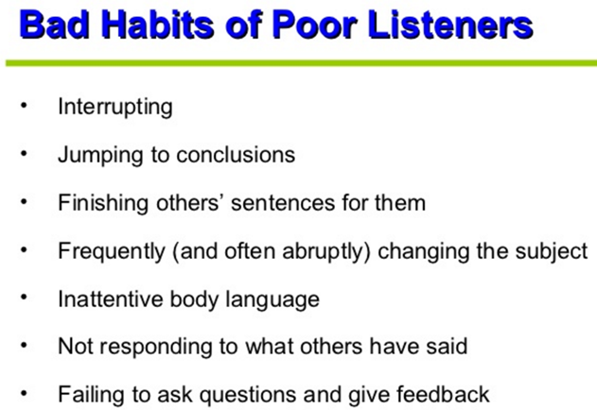

Slide 2
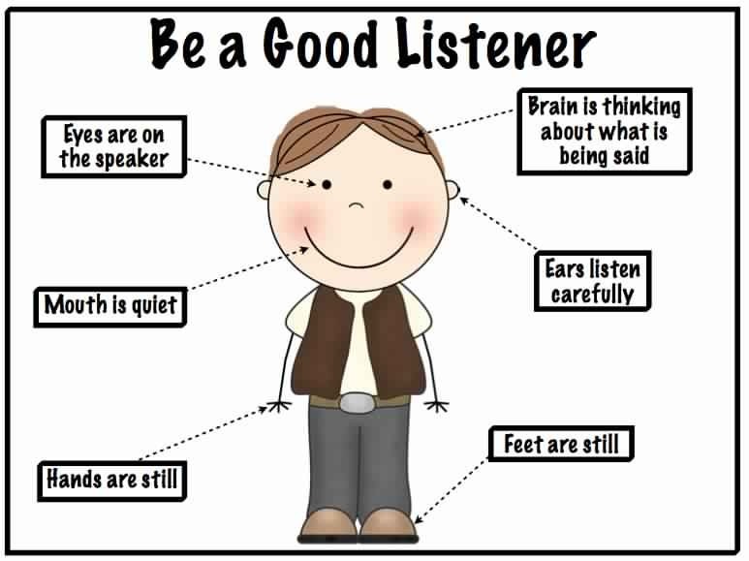

Slide 3

Basic Presentation Skills
Shane M. Drews
Shane X. E. Zhuo
[卓學恩] Xue En Shane Zhuo

Slide 4
Basic Presentation Skills
You dress appropriately for a presentation, including your clothes and shoes. Any shorts, t-shirts, jeans, torn clothing, “sexy” clothing, sports shoes, sandals, “slippers,” sloppy clothing, etc. will result in a point loss.

Slide 5
Basic Presentation Skills
You go to your title slide
Signal the start (non-verbally) by looking around the audience and maintaining eye contact while you smile.
Then you start by saying your name so others can hear how it is pronounced.
This takes about 5 – 10 seconds.

Slide 6
Basic Presentation Skills
You have an opening:
Quote
“What if” or “Imagine” scenario
Rhetorical question
Startling statistic
Powerful statement or phrase
An anecdote
An action

Slide 7
Basic Presentation Skills
The opening and the first 20 – 30 seconds are the most important part of any presentation. Therefore, the opening should be memorized*. as you maintain eye contact with the audience while you speak.
*There are only two parts of a presentation that should be memorized. You can and should use notes made from your outline for the rest of it.

Slide 8
Basic Presentation Skills
Then, you move to the Body of your presentation. The “body” is All of the I, II, III, IV, 1, 2, 3, 4, A, B, C, and D on your outline.
This is the part where many in the audience begin to lose interest. So you need to learn how to make sure they stay alert throughout your awesomeness.

Slide 9
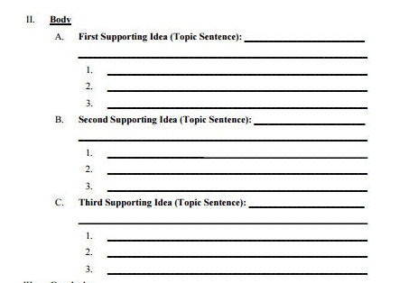
Basic Presentation Skills
Make an outline for every presentation.

Slide 10
Basic Presentation Skills
Attract the audience in two ways:
Verbally & Non-verbally

Slide 11
Basic Presentation Skills
Attract the audience Verbally (mostly)
Fluency
Accuracy
Intonation
Enunciation
Word Stress
Vocabulary Choices & Clarity

Slide 12
Basic Presentation Skills
Attract the audience Non-verbally (sometimes)
Do have a comfortable stance & move occasionally.
Do move your hands occasionally.
You can point to the screen but don’t stand in the light or touch the screen.

Slide 13
Basic Presentation Skills
Attract the audience Non-verbally (sometimes)
DON’T ACT! EVER!
Don’t read the screen to us!
Don’t stand like statue.
Don’t move around so much: this is not an exercise class
Don’t over gesticulate

Slide 14
Basic Presentation Skills
Attract the audience Non-verbally (sometimes)
Oh, and don’t have more than 4
pictures per slide! (But 3 is usually better.)

Slide 15
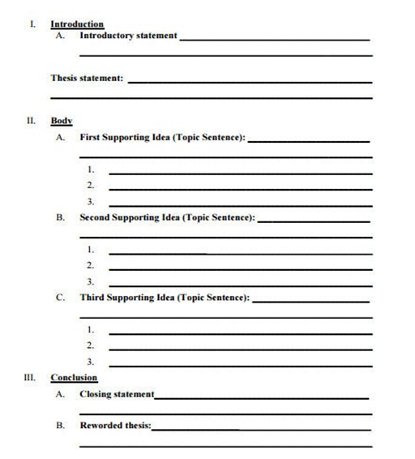
Basic Presentation Skills
Your outline will make it easier for the audience to follow your presentation.

Slide 16
Basic Presentation Skills
If you are passionate and interested in your topic, then your audience will likely be interested in your presentation.

Slide 17
Basic Presentation Skills
Real life, personal examples and pictures can usually help to explain material more easily than words alone.
“A picture paints a thousand words.”

Slide 18
Basic Presentation Skills
The end is near…
FIRST > Signal the end is approaching (words)

Slide 19
Basic Presentation Skills
The end is near…
FIRST > Signal the end is approaching (words)
This is the second most important part of a presentation. It must be done as well as the introduction. Therefore, this is the second and only other part of a presentation that should be memorized. You can & should use notes for the rest of it.

Slide 20
Basic Presentation Skills
Finally > you end your presentation
Use thoughtful, open-ended questions
Quote a well-known person
Refer back to your beginning—restate or paraphrase your beginning
Call the audience to take action
Recommendations, suggestions or solutions
Make a prediction
Give your personal opinion

Slide 21

Basic Presentation Skills
This slide (#2) is also required in all presentations!

Slide 22
Basic Presentation Skills
Q & A
During Q & A, you lose all question points for ANY “canned” (放水題，套招，
制式問題) questions.

Slide 23
Basic Presentation Skills
Q & A
When you prepare your presentation, THINK about what questions your audience might ask you? (What questions would you ask if you saw this presentation?)
Q & A time is limited to one minute in most situations.

Slide 24
Basic Presentation Skills
References is your #3 required slide
Where exactly did your information and/or photos come from?

Slide 25
Basic Presentation Skills
References (Sources):
https://bharat-bikash.blogspot.com/2019/07/good-listener-vs-good-speaker.html
https://www.passionineducation.com/etiquette-manners-important/
https://www.keepcalmandposters.com/poster/5237654_keep_calm_and_be_a_good_listener_to_be_a_good_speaker
https://www.yourquote.in/aditya-prasad-raiguru-ht4f/quotes/good-listener-good-speaker-just-like-good-learner-good-fcy0z
https://en.wikipedia.org/wiki/Jolin_Tsai
https://www.reddit.com/r/coolguides/comments/etqtxb/dress_codes_for_both_genders/
https://www.pinterest.com/pin/227924431127923267/
https://wanna-joke.com/always-smile/
https://www.thoughtco.com/practice-stress-and-intonation-1211971
https://www.managers.org.uk/insights/news/2015/april/how-do-i-come-across-as-more-passionate
https://www.verywellmind.com/how-do-i-maintain-good-eye-contact-3024392
http://realitysideb.blogspot.com/2009/09/vader-used-to-practice-in-front-of.html
https://www.jarofquotes.com/view.php?id=simplicity-is-key-to-beauty-clarity-is-key-to-perfection-david-nevue
https://acegif.com/i-love-you-gifs/
https://medium.com/@andyharringt0n/https-medium-com-andyharringt0n-how-do-you-stand-df9afb33743c
https://en.wikipedia.org/wiki/File:Love_Heart_SVG.svg

Slide 26
Basic Presentation Skills
Thank you is your final required slide #4.

Slide 27
Basic Presentation Skills
Thank You
for your kind attention

